Slide 1


Electric Current, Current Density and Drift Speed, Resistance & Resistivity, Ohm’s Law
Chapter 26:Current and Resistance

Slide 2
26-1 Electric Current
Learning Objectives
26.01 Apply the definition of current as the rate at which charge moves through a point, including solving for the amount of charge that passes the point in a given time interval.
26.02 Identify that current is normally due to the motion of conduction electrons that are driven by electric fields (such as those set up in a wire by a battery).
26.03 Identify a junction in a circuit and apply the fact that (due to conservation of charge) the total current into a junction must equal the total current out of the junction.
26.04 Explain how current arrows are drawn in a schematic diagram of a circuit, and identify that the arrows are not vectors.

Slide 3
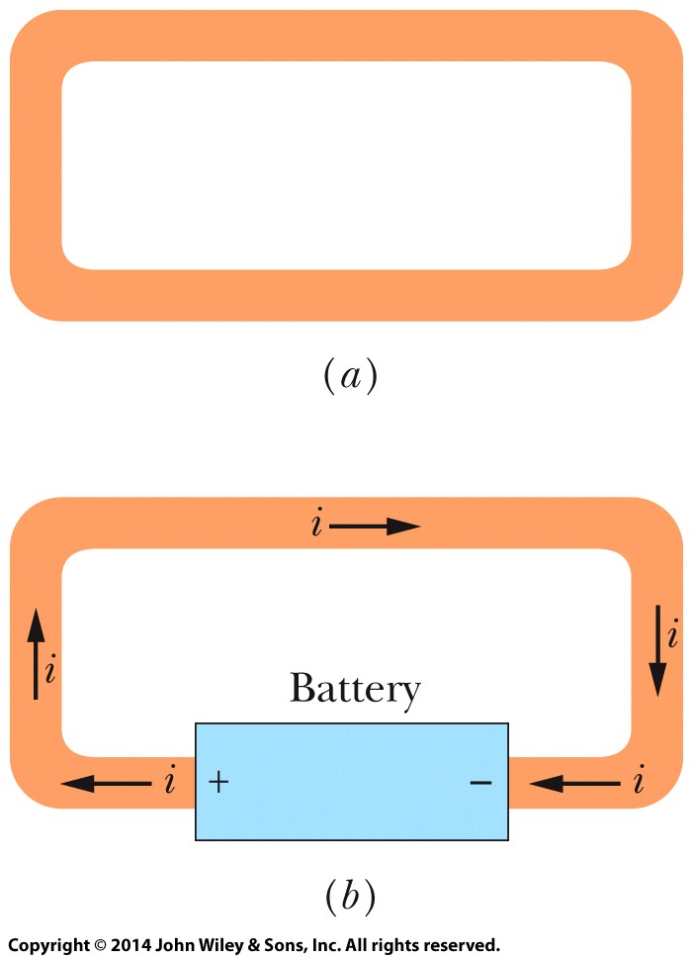
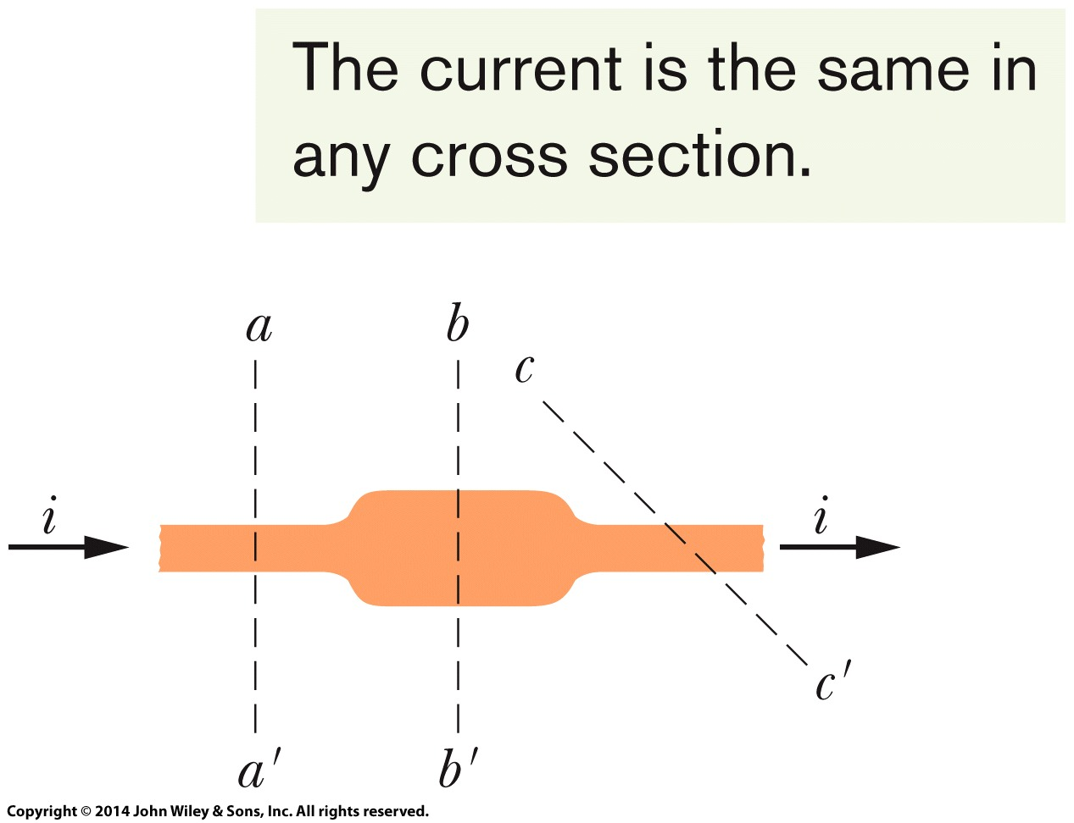

26-1 Electric Current
As Fig. (a) reminds us, any isolated conducting loop—regardless of whether it has an excess charge — is all at the same potential. No electric field can exist within it or along its surface.
If we insert a battery in the loop, as in Fig. (b), the conducting loop is no longer at a single potential. Electric fields act inside the material making up the loop, exerting forces on internal charges, causing them to move and thus establishing a current. (The diagram assumes the motion of positive charges moving clockwise.)
Figure c shows a section of a conductor, part of a conducting loop in which current has been established. If charge dq passes through a hypothetical plane (such as aa’) in time dt, then the current i through that plane is defined as
(c)

Slide 4
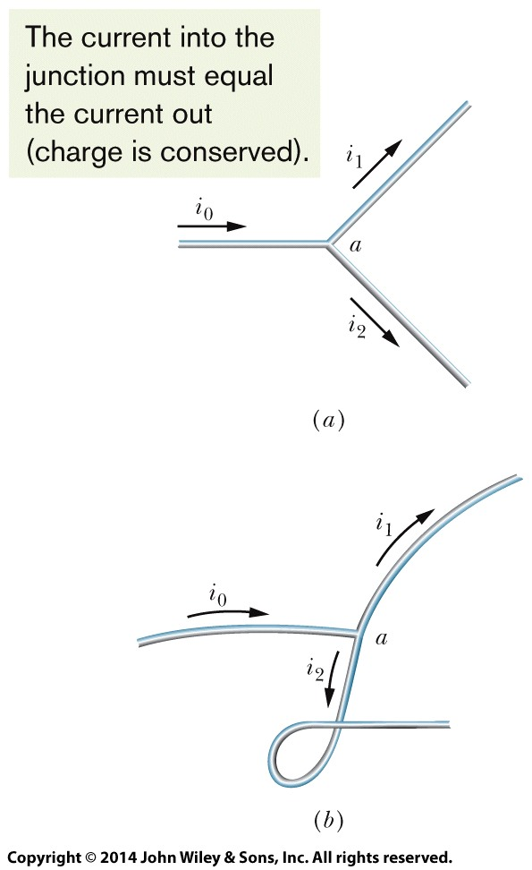


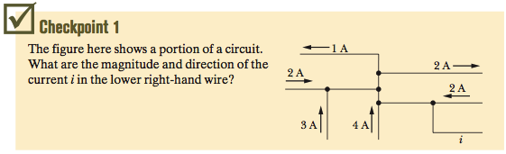
26-1 Electric Current
Figure (a) shows a conductor with current i₀ splitting at a junction into two branches. Because charge is conserved, the magnitudes of the currents in the branches must add to yield the magnitude of the current in the original conductor, so that
Figure (b) suggests, bending or reorienting the wires in space does not change the validity of the above equation Current arrows show only a direction (or sense) of flow along a conductor, not a direction in space.
Answer: 8A with arrow
pointing right

Slide 5
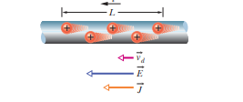



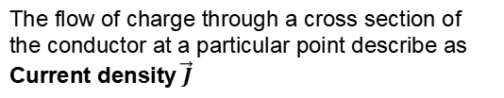
Current Density, Drift Speed
The flow of charge through a cross section of the conductor at a particular point describe as Current density $\vec{J}$

Slide 6
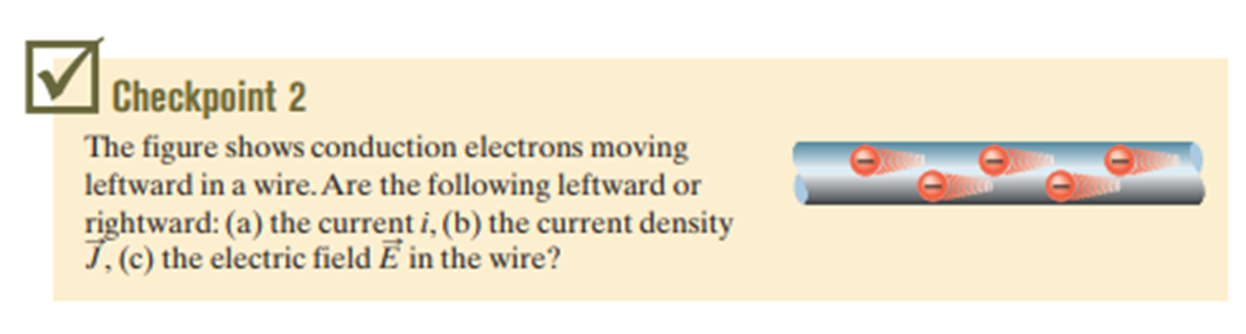

Slide 7
26-3 Resistance and Resistivity
Learning Objectives
26.14 Apply the relationship between the potential difference V applied across an object, the object’s resistance R, and the resulting current i through the object, between the application points.
26.15 Identify a resistor.
26.16 Apply the relationship between the electric field magnitude E set up at a point in a given material, the material’s resistivity ρ, and the resulting current density magnitude J at that point.
26.17 For a uniform electric field set up in a wire, apply the relationship between the electric field magnitude E, the potential difference V between the two ends, and the wire’s length L.
26.18 Apply the relationship between resistivity ρ and conductivity σ.
26.19 Apply the relationship between an object’s resistance R, the resistivity of its material ρ, its length L, and its cross-sectional area A.

Slide 8
26-3 Resistance and Resistivity
Learning Objectives (Continued)
26.20 Apply the equation that approximately gives a conductor’s resistivity ρ as a function of temperature T.
26.21 Sketch a graph of resistivity ρ versus temperature T for a metal.

Slide 9


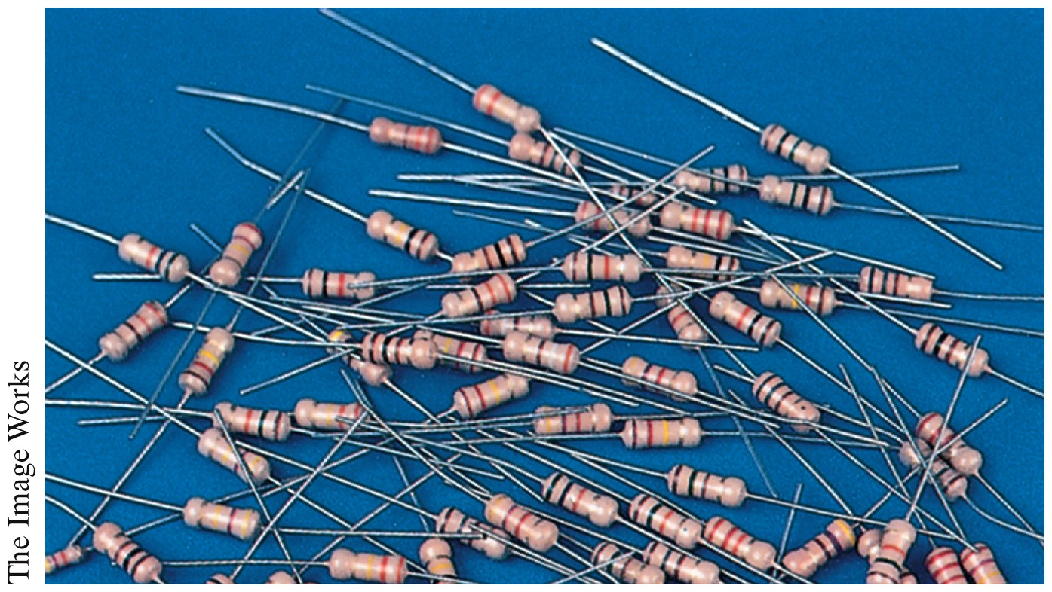

26-3 Resistance and Resistivity
If we apply the same potential difference between the ends of geometrically similar rods of copper and of glass, very different currents result. The characteristic of the conductor that enters here is its electrical resistance. The resistance R of a conductor is defined as
where V is the potential difference across the conductor and i is the current through the conductor. Instead of the resistance R of an object, we may deal with the resistivity ρ of the material:
The reciprocal of resistivity is conductivity σ of the material:
Assortment of Resistors

Slide 10
26-4 Ohm’s Law
Learning Objectives
26.22 Distinguish between an object that obeys Ohm’s law and one that does not.
26.23 Distinguish between a material that obeys Ohm’s law and one that does not.
26.24 Describe the general motion of a conduction electron in a current.
26.25 For the conduction electrons in a conductor, explain the relationship between the mean free time τ, the effective speed, and the thermal (random) motion.
26.26 Apply the relationship between resistivity ρ, number density n of conduction electrons, and the mean free time τ of the electrons.

Slide 11
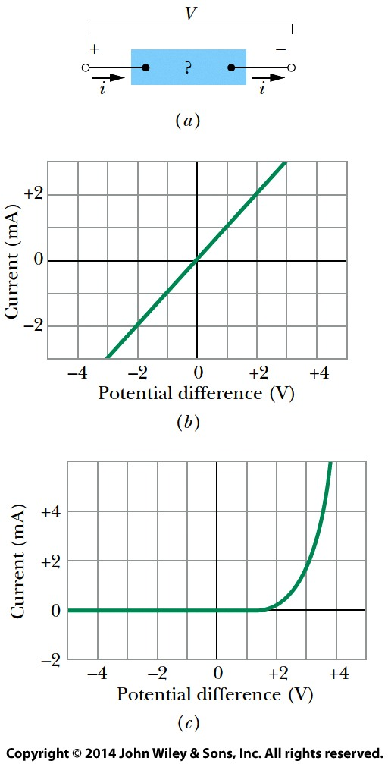
26-4 Ohm’s Law
Figure (a) shows how to distinguish among devices. A potential difference V is applied across the device being tested, and the resulting current i through the device is measured as V is varied in both magnitude and polarity.
Figure (b) is a plot of i versus V for one device. This plot is a straight line passing through the origin, so the ratio i/V (which is the slope of the straight line) is the same for all values of V. This means that the resistance R = V/i of the device is independent of the magnitude and polarity of the applied potential difference V.
Figure (c) is a plot for another conducting device. Current can exist in this device only when the polarity of V is positive and the applied potential difference is more than about 1.5 V. When current does exist, the relation between i and V is not linear; it depends on the value of the applied potential difference V.

Slide 12



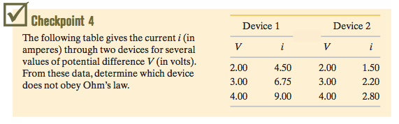
26-4 Ohm’s Law
I ~ V or I = V/R
Answer: Device 2 does not follow ohm’s law.

Slide 13





26 Summary
Current
The electric current i in a conductor is defined by
Resistance of a Conductor
Resistance R of a conductor is defined by
Similarly the resistivity and conductivity of a material is defined by
Resistance of a conducting wire of length L and uniform cross section is
Eq. 26-1
Eq. 26-8
Current Density
Current is related to current density by
Eq. 26-4
Eq. 26-10&12
Drift Speed of the Charge Carriers
Drift speed of the charge carriers in an applied electric field is related to current density by
Eq. 26-16
Change of ρ with Temperature
The resistivity of most material changes with temperature and is given as
Eq. 26-7
Eq. 26-17
Notes:
3

Slide 14


26 Summary
Ohm’s Law
A given device (conductor, resistor, or any other electrical device) obeys Ohm’s law if its resistance R (defined by Eq. 26-8 as V/i) is independent of the applied potential difference V.
Power
The power P, or rate of energy transfer, in an electrical device across which a potential difference V is maintained is
If the device is a resistor, we can write
Eq. 26-26
Resistivity of a Metal
By assuming that the conduction electrons in a metal are free to move like the molecules of a gas, it is possible to derive an expression for the resistivity of a metal:
Eq. 26-27&28
Eq. 26-22
Notes:
3

Slide 15
